Slide 1
Outputs 2020-2021
Publications
Meetings
171
Peer-reviewed
?
Workshops
59
in 2 Frontiers in Marine
Science Research Topics
?
Conference sessions
?
Training courses
1
Policy relevant report
Notes:
56+24 class one 22 class 2
78 + 24 = 102
Cliotop pubs – 17 conf – workshop – other pres – 8 session chair 4
ICED pubs 3, but more – conf – workshop 1 – other 2 session
ESSAS pubs 10(2)– conf – workshop 3 - other
SIBER pubs 21(11) – conf – workshop – other 4 sessions 1 pres
CMWG pubs – conf – workshop 4 – other 2 pres
HDWG pubs (9)– conf – workshop – other
SIOA pubs 5 – conf – workshop 1 – other 5 training courses 1 sessions
IOC-R pubs – conf – workshop – other
Imecan 1 workshop
Research topics 24
Recalculated from report to SCOR
Peer-reviewed 138+24 = 162
Non-peer reviewed 9 -

Slide 2
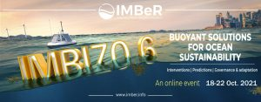
Activities
Pictures that convey a few of the new science plan priorities from the midterm review ?
Data hub ?
Fisheries and aquaculture
Marine spatial planning
IC4, 5 and 6

Slide 3
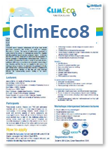
Events in 2021-2022
2nd

